Slide 1














Operational Threat & Risk Information Sharing and Analytics
TEAM Threat
Face-face
Aug 2015

Slide 2
Face-face agenda
Proposed
Subject to change
Monday AM
Welcome and focus for the week
Overview of where we are and what we need to do (this document) – Cory Casanave
Monday PM
General model approach and overview – Cory Casanave
Review scope and schedule, add or eliminate sections
Priorities and planning – team discussion
Choices for baseline – team discussion
Team dynamics & operation
Teaming agreement

Slide 3
Face-face agenda
Tuesday AM
Detailed conceptual model review – core abstractions
Detailed conceptual model review – threats
Tuesday PM
Detailed conceptual model review – risks
Review of NIEM mapping and way forward
Review of STIX mapping and way forward
Wednesday AM
Discuss issues & incomplete sections in current specification
Wednesday PM
Choices and responsibilities for mappings
Team leads for tasks/sections
Review of scope, schedule and level of effort
Thursday – flex time based on other discussions

Slide 4
Overview & Orientation Agenda
Who is on the submission team
Quick review – OMG Process going forward
Identifying the “core team” – doing the bulk of the work
Team policies and procedures
Resources: Mail list, GIT site, threatrisk.org. Others?
Teaming agreement
The other submission teams
Merging and incorporating new submitters and contributors
Use cases and data
Task list and dependencies for final submission
Task focus areas and teams
Scheduled meetings
Reference implementations and pilot projects
Other topics

Slide 5
Planning required (no particular order)
Understand and agree on the processes and approach of the submission team
Review the OMG process and time-line
Teaming agreement
Review what needs to be done for the final submission
Establish team roles and key contributors (who is doing real work)
Understand how we are modeling (conceptual and transformations)
Review current conceptual model
Show prototyping progress and importance of sample data
Determine scope of model in multiple dimensions
Review primary “input” schema, ontologies and use cases (More Below)
Submission tasks (More Below)
Engaging stakeholders
Reference implementations and pilot projects

Slide 6
Submission tasks
Normative machine readable specifications
Formally define and document conceptual model
STIX Subset and mapping
NIEM subset and mapping
EDXL subset and mapping
Profiles and meta-models
Any other mappings
Submission Document
Resolution of requirements
Mission and purpose
Usage scenarios
Approach
Conceptual model overview
Conceptual/physical patterns
Use of SIMF
Improve generation from models

Slide 7
Submission Tasks (Cont)
Modeling and transformatio9n rules
Document conceptual profile
Document transformation language, rules and profile
Dependency with SIMF
Examples
STIX Example
NIEM Example
EDXL Example
Other Examples
SIMF (Semantic Information Modeling for Federation)
Conceptual overview
Core meta model
Mapping meta model
Formalization
Syntax
UML Profile

Slide 8
Overview of OMG RFP Process & Revised Time Line
OMG TC Meeting
March 23rd 2015
OMG TC Meeting
June 18th 2015
OMG TC Meeting
Dec. 7th 2015
OMG TC Meeting
March 14th 2016
Issue RFP
Initial Submission
Revised Submission (May be multiples)
Draft Submission
Task Force, AB Vote (Could happen in Nov)
June 2014
March. 23rd
2015
May 18th
2015
Nov 9th
2015
March 14 2016
OMG TC Meeting
June, 2016
If passed, TC Vote Starts
TC Vote Completes
BoD Vote – Beta spec adopted
Finalization TF process
Finalization TF Final Specification
Final Review, votes, adoption
March 2016
May 2016
June 2016
Thru 2016
Late 2016
Late 2016

Slide 9
What we all should already know

Slide 10
What we need is an integrating framework
Cyber
Crime
Terrorism
Critical Infrastructure
Natural
Disasters
Integrating Framework for Threats and Risks
Sharing & Analytics
Sharing & Analytics
Sharing & Analytics
Sharing & Analytics
Sharing & Analytics
An integrating framework that helps us deal with all aspects of a risk or incident
A federation of risk and threat information sharing and analytics capabilities

Slide 11
Scope Diagram
Wide & shallow conceptual model generically covering threats and risks
Other risks (Out of scope)
Operational Threat & Risk Concepts
High level Cyber-threat/risk concepts
Law Enforcement / Emergency Management Concepts
Physical. Spectrum, facilities,
Probabilities, Forensic, Chemical, Biological, Medical, Nuclear, Military and Intelligence threats concepts
STIX/TAXII/Cybox
IODEF
SACM
ISO
NIST
Others…
NIEM Threat/Risk Representation
Other Risks
Systemic Risk
Credit Risk
Market Risk
Pension Risk
Reputation Risk
Liquidity Risk
Legal Risk
Project Management Risk
Legend
Normative
(Formal Specification)
NIEM Exchanges
EDXL / CAP
Others…
Other Inputs
In Scope with Limited Detail
Informative

Slide 12
Critical Components – conceptual models and mappings
External
Conceptual Modeling Profile (From SIMF)
Mapping Profile (From SIMF)
XSD Profile
(From IMM)
Depends On
Uses
Uses
Uses
Uses
Generic and threat-risk conceptual models
STIX/Cybox Mapping
STIX/Cybox UML Import
NIEM Mapping
NIEM-UML
More…
More…

Slide 13

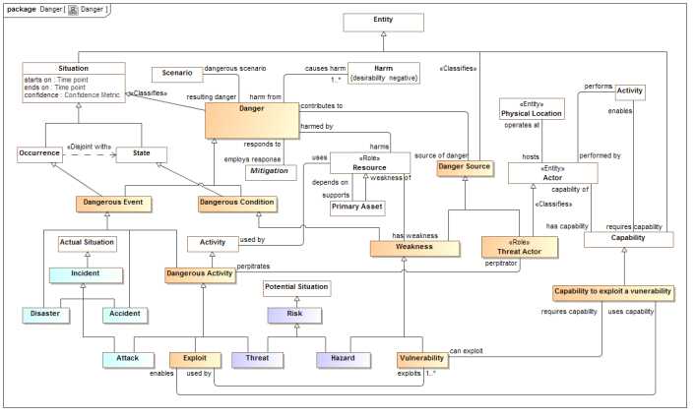
Conceptual Model Inputs (Initial)
KDM
(Risk)
NIST Framework
Conceptual Model
NIEM
(General)
STIX
(Cyber)
OGC
(Geo)
EDXL
(Emergency)
FIBO (Finance)
SEI
(Safety)
CAL OES
(Health)
MAP
ISO
(Risk)
ISO
(Units)
RMS
(Custody)
STIX, NIEM, EDXL, Others
There is still more to do to fully integrate the above and we anticipate more inputs and use cases

Slide 14
What it means to create a standard
This intent of this section is to establish the process by which operational threat and risk contributors will collaborate to produce the standards and capabilities that meet our shared objectives

Slide 15
Submission Team

Slide 16
Contributors & Submitters
This presentation is intended for parties that have agreed to engage in the community developing standards and capabilities for operational threat and risk information sharing and analytics.
It is assumed you already understand the value proposition and approach we are using, however you are not expected to be experts in data federation, standards or modeling.
Our initial work product is a response to the OMG Operational Threat & Risk RFP. You are part of the submission team and this is our current focus.
You may be a formal submitter (OMG Platform Membership required) or a contributor (Release of I.P. Required)
There may be other associated efforts such as pilot projects or mappings to data formats important in your domain, these associated efforts will benefit from and inform the standards effort but are independent efforts.

Slide 17
Submitters
Current Submitters
Model Driven Solutions, a division of Data Access Technologies, Inc.
KDM Analytics
International Business Machines
EMC, Inc.
Lockheed Martin, Inc.
Oracle Corporation

Slide 18
Contributors
Contributors:
Demandware, Inc.
Duke Energy
INCOSE
Tibco Software Inc.
Integrated Networking Technologies, Inc.
Government Contributors
U.S. Air force
U.S. Defense Security Services
California Public Safety
U.S. National Information Sharing Model PMO
NSA/UCDMO
NIST
U.S. Information Sharing Environment PMO
FBI Infogard

Slide 19
Core Team
The core team integrates requirements and specific data structures into the cross-domain conceptual model and related mappings.
The core team will help to facilitate structuring stakeholders information such that it can be verifiably integrated with other data formats and vocabularies in other domains.
This cross domain conceptual model will then be mapped to domain specific data structures such as XML or SQL schema as well as domain vocabularies and models.
It is assumed we already understand your domain use cases at a high level, but we are not experts in your domain and will require guidance and domain expertise to be actively engaged.

Slide 20
Change process, team dynamics
At this meeting we should agree to use the current model as the baseline, or come up with an alternative plan
Given a baseline issues should be raised and fixed by the core team.
Any contributor can propose a change or replacement of anything, but such change proposals should be complete.
As much as possible we will agree by consensus. Votes can be taken (one vote per org) if need be.
Validation scenarios are welcome, but should be detailed and include specific data
New contributors will only be accepted based on a vote of the current team.
Any member may drop-out but must inform the group

Slide 21
Understanding the standards process

Slide 22
Some thoughts about creating a standard
A warm and fuzzy feeling does not a specification make
Information architecture and data federation is a team sport
We want to focus on concepts, not get hung up on specific terms
We are not standardizing processes, we are standardizing the information that supports multiple processes. Processes can be informative but are not our focus.
It will take time for us to understand each other, we will need to talk things through in a productive manor. Resolving disagreements and different points of view is normal and constructive. The process will be iterative.
There are several ways we can present information, but in the end you will need to expend effort to understand and validate it as we will need to expend effort to understand your perspectives
The final specification must:
Be formal, precise and conform to OMG requirements and expectations
Have the commitment for implementations (open source and/or commercial)
Have sufficient industry buy-in for success
Satisfy RFP requirements
The standards process does not end on initial submission– the finalization process takes about an additional year. The community supporting a standard must be sustained for as long as the specification is relevant or it will die. A vibrant community make a standard an industry capability.

Slide 23
What we need for the specification
Our current focus is a response to the OMG Operational threat/risk RFP. The current date for the revised submission is Aug. 24th . Specific requirements are located in the appendix, key components are:
Use cases for cross domain information sharing and analytics – this includes data sources, data destinations and requirements for analytics.
A broad-based and detailed conceptual model of the terms and concepts relevant to sharing and analyzing cross-domain operational threat and risk information.
Computational mappings of this conceptual model to multiple existing information sharing data structures, including but not limited to NIEM, STIX & EDXL.
A “Computational mapping” means that software implementing the standard will be able to ingest, correlate and export data in any of the mapped formats for the subset of information described in the conceptual model.
Test cases – to validate conformance (Not strictly required, but highly recommended)
The specification includes the formal document as well as the “machine consumable files” for the models, mappings and any examples.
We also need to validate and prove that the mappings work, both computationally and for the intended domain use cases

Slide 24
Validation
Validation in this context means:
At the schema and conceptual level
We have provided the relevant normative data and vocabulary specifications. [Stakeholders do this]
That we have described precisely how data in the various formats and vocabularies relates to conceptual model elements, expanding or refactoring the conceptual model as required. [We do this together]
That we have computationally validated that the models and mappings are consistent and well formed [Core team mostly do this].
That stakeholders have validated that the mappings are valid and cover the subset of information required for cross domain information sharing and analytics. [Stakeholders do this with Core team help]
At the “real data” level
You have provided sufficient real or sample data to validate all of the use cases. [Stakeholders do this]
That we have specific data instances that computationally demonstrate the mapping in both directions. [Core team does this]
That stakeholders have validated that the interpretation of the data is correct in these instances and that the resulting data meets the needs described by the domain use cases. [Stakeholders do this with Core team help]

Slide 25
Implementations
There are multiple implementation activities that may take place concurrently with or after the standards effort
No implementation effort is required (by OMG) to submit an OMG specification, however in this case it would be difficult to produce a realistic specification without some implementation experience and validation. Implementation commitment is required for an OMG standard to be adopted by the OMG Board.
Prototypes: Prototypes help prove and validate the specification. In this context prototyping is needed to validate that our models are consistent and to computationally demonstrate and validate data mappings. Prototypes are not intended to be part of operational systems.
Pilots: Pilots utilize some aspect of the specification to solve a real-world problem - this demonstrates usefulness and practicality. Pilots may or may not be deployable as operational systems.
Reference implementations: Reference implementations, typically open source, provide a complete “sample” implementation of the specification. This can help those implementing solutions or commercial products and serves to support testing. While the community may recognize a reference implementation, OMG can not.
Products (open source or commercial): Products are software products that conform to the specification and can be deployed to solve real-world problems (applications or systems) or enable the solution of real-world problems (tools and infrastructure). Of course products have to be sustained, supported and evolved.
Implementation plans are, at this time TBD. We have started simple prototyping.

Slide 26
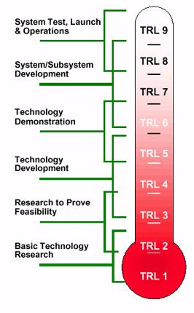
Consider the technology readiness level required for any pilots/prototypes

Slide 27
Potential Roadmap
Evolving use cases
Multiple collaboration sessions to focus scope, understanding and intent
Source data and schema
Validation sessions (like this one)
Initial specification and prototype incorporating 2 domain mappings
One or two pilot projects concurrent with the specification process
Final revised specification is delivered with a “beta” unofficial open source reference implementation and 4 domain mappings
Open source reference implementation and at least one commercial product is released within one year of adoption

Slide 28
Understanding the conceptual models

Slide 29
Conceptual Model Layering
Operational threat situational awareness and response
Operational risk evaluation and mediation
Cross-risk/threat – specific “wide and shallow” risk and threat concepts/ E.G. Risk, threat, danger, consequence
Generic Library – Provides concepts and links across multiple viewpoints, not just threat/risk. E.G. Person, Objective
Kernel– Foundational concepts for modeling anything: Entities, Roles, Relations, Types, Information, Rules, Identity, Etc…
Subset of the model from SIMF

Slide 30
Conceptual Model Packages
Core Concepts
Foundation
Identifiers
Information
Process
Quantities and Units
Rules
Templates
Timeframe
Generic Concepts
Authority
Capability
Contact Information
Custody
Enterprise
Entity Kinds
Intent
Location
Observation
Party relationships
Person
Prediction
Requirements
Resources
Threat and Risk Concepts
Campaign
Course of Action
Danger
Danger Categories
Incident
Indicator
Risk
Vulnerability

Slide 31
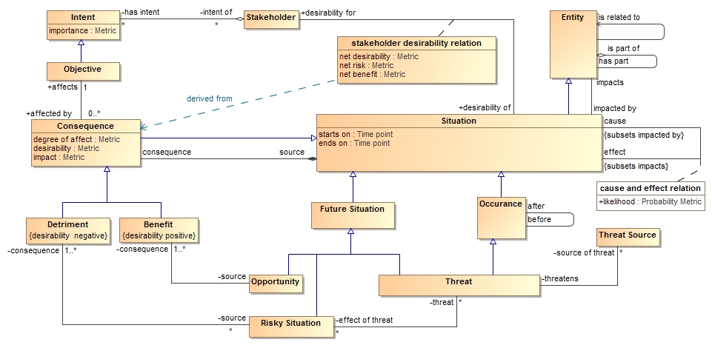
Understanding the UML diagrams & Tables
--todo--
More specific concepts positioned on the bottom

Slide 32
UML Concepts we use
Classes {Entities}
Data types and primitive types {Values}
Associations, associations ends {Relation types}
Properties for values {Simple property relations}
Property defaults {Refinement: An expression evaluated if no values set in context}
Association classes (However, all associations and properties are considered “first class” and can have contextual and time properties)
Subsets and redefines of association ends {Properties of relations}
Cardinalities {Constraint}
Packages & Package URI {Lexical and logical context}
Realization {Representation realizes concept}
Structured Classifier {Patterns and rules}

Slide 33
Profile extension concepts
Classifying packages
Conceptual Model, Physical Model, Mapping
Classification / classifies
Role & Phase
Kinds of types
Entity, Quantity Kind, Unit
Relations
Intersection and Union classes
Equivalent with, disjoint with, is in context of, Restriction
Represents
Rule {Mapping}

Slide 34
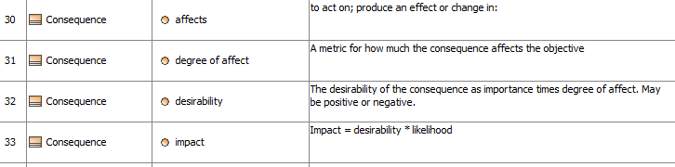
Representing the data and schema
Options
UML Diagrams
Tables
Schema

Slide 35
Modeling Convention – General Relations
In the conceptual model
In a representation (E.G. STIX)
It is typical in a data model and some ontologies to have many specializations for the same relation concept, but different “end types”.
In the conceptual model we have the general concept “related <entity>”.
“represents” semantics say that a general relation is only mapped to a more specific representation if the ends of that relation representation also represent the correct end types.
So, one general type covers many more specific relations and properties.
RelatedCampaign <Campaign>
RelatedIndicators <Indicator>
RelatedTTP <TTP>
The pattern is: Related<type> <type>
Etc…
All the above Represent “related <entity>”

Slide 36
Threat/Risk Conceptual Model
Examples of specific risk/threat concepts – intended to show how the conceptual model is being produced

Slide 37
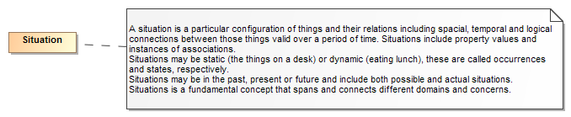
Threats and Risks of What?
A threat or risk is with respect to some undesirable situation
What is a situation?
We define a situation as a configuration of things…
People places, things, events, occurrences and the connections between them.
Some situations are consequences of others
Situations provide a link between different kinds and phases of threats & risks

Slide 38
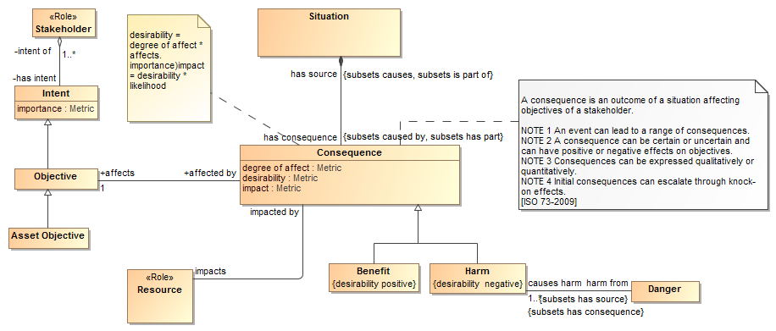
Consequences
Situations may have consequences (an effect of the situation)
Consequence can be positive or negative: benefits or detriments, respectively
Consequences affect the objectives of stakeholders
This leads to the desirability of the consequence (positive or negative)
Desirability * likelihood provide the impact (→risk metric for detriments)

Slide 39
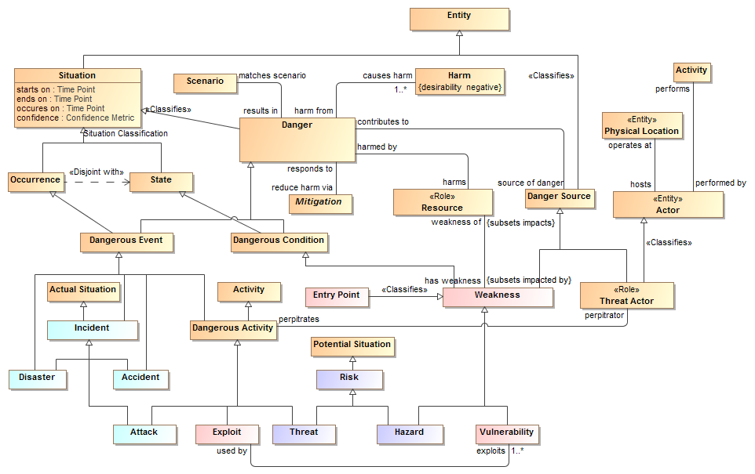
“Danger” as the threat/risk common abstraction (Firesmith)

Slide 40
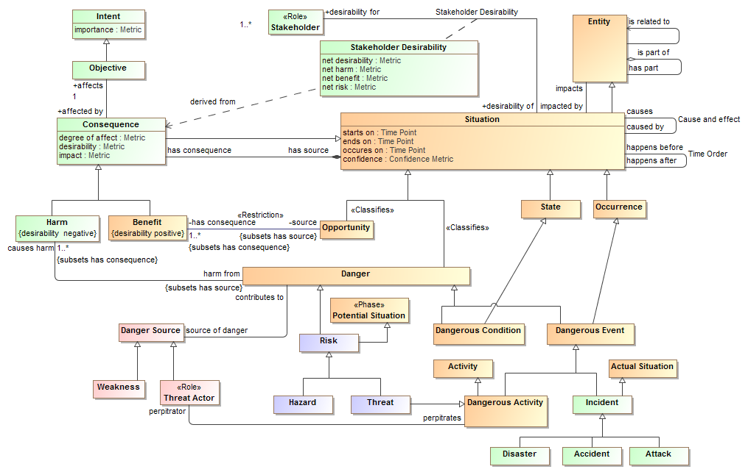
Core Risk/Threat Concepts Overview

Slide 41
Thought
“Threat” seems to work well and is reasonably consistent across the litrature
“Risk” has multiple interpretations. Do we have it right?
Risk as a bad situation that may happen
Risk as a metric
Risk as a process
Enterprise Vs. generic risk

Slide 42
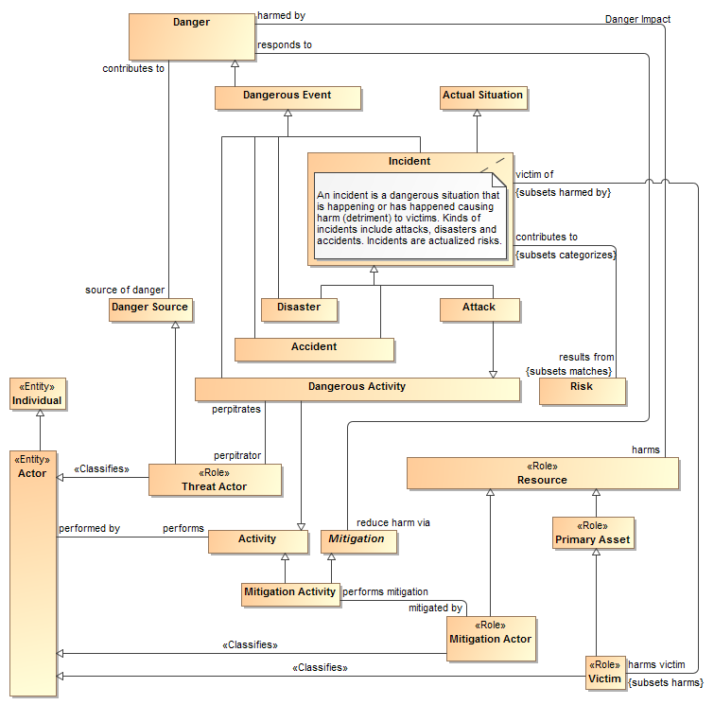
Incidents

Slide 43
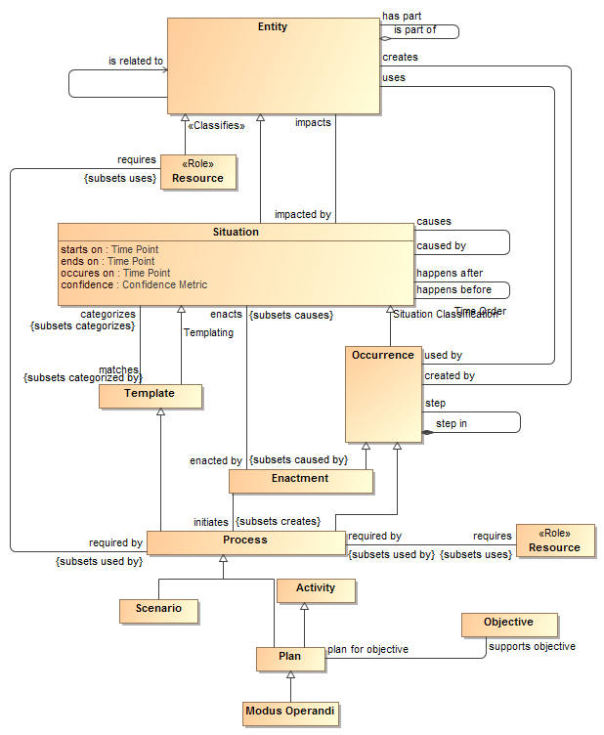
Processes and plans

Slide 44
Abstract types
When we create a new verb concept, we ask “what is the most general possible “ends” of that concept.
If necessary we add abstract super types, there tend to be just a few of these.
So we end up with a hierarchy of very general concepts.

Slide 45
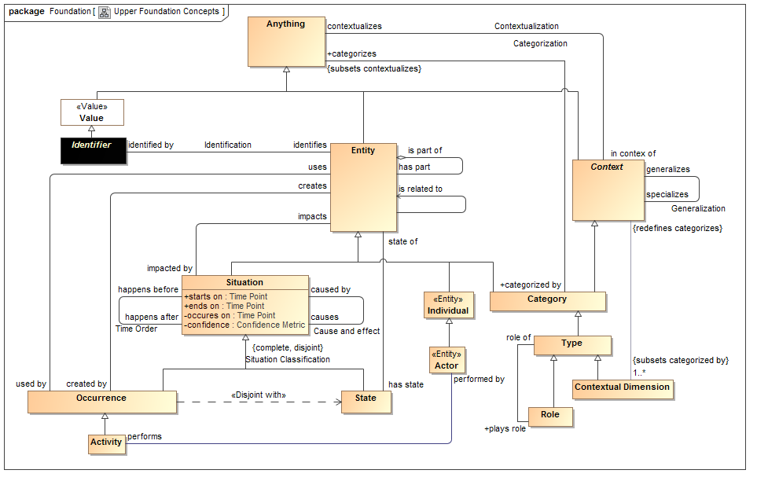
Upper / generic concepts

Slide 46
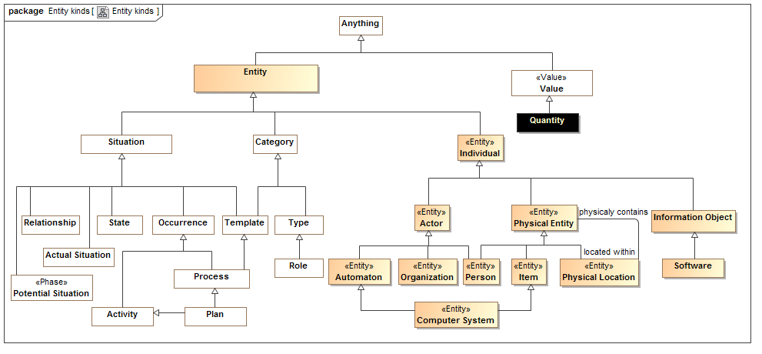
Kinds of entities

Slide 47
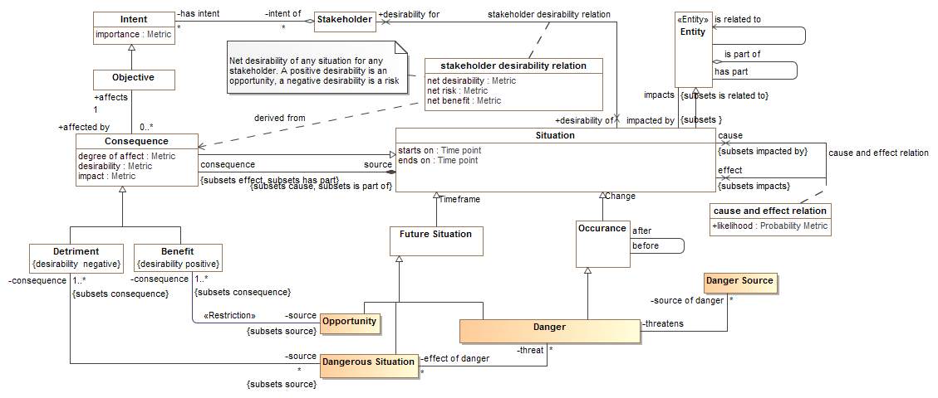
Abstract concepts are then supertypes of Risk/Threat specific concepts
General Framework
Threat specific

Slide 48
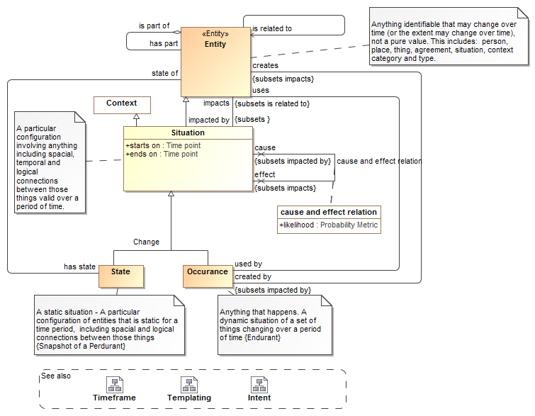
Each concept has a definition and focus diagram
These are also important upper concepts to understand

Slide 49
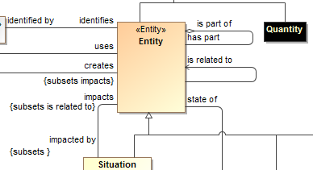
Hierarchy of verb and property concepts
Like types, verbs and relation roles can also form a hierarch and specialize each other
This is defined with UML “subsets” and Redefines”
Subsets defines a refinement of another end, but still allows the original definition
Redefines does not allow the original definition in the new context
This is like “subproperty” in OWL and RDF

Slide 50
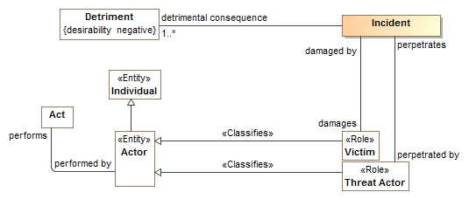
Roles
Roles define what something is for or how it behaves in a certain context, not “what it is”.
A role <<Classifies>> what it can be a role of.
An entity can play any umber of roles and these roles may change over time.
Roles can be contextual

Slide 51
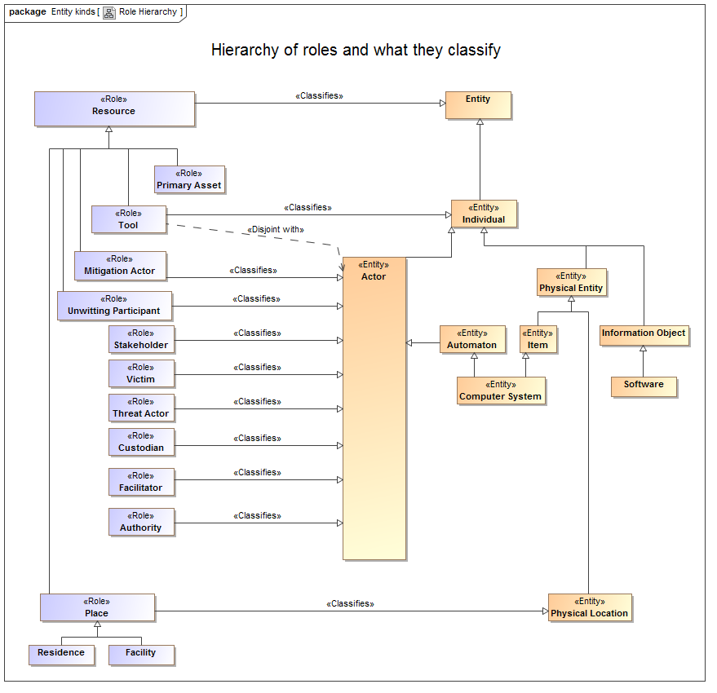

Slide 52
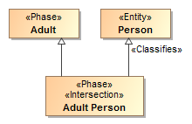
Phases
Phases (or states) are classifications of objects over their lifetime.
Examples: Child, Teenager, Adult or Invoiced, Late, Paid

Slide 53

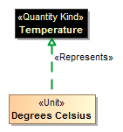

Quantity Kinds
For numeric properties, we want to know what it means (e.g. Temperature), not the kind of number (Real).
<<Quantity Kind>> is an aspect common to mutually comparable quantities represented by one or more units.
A unit represents a quantity kind, there are multiple units representing temperature.
A physical representation would then represent the unit as some kind of number in a specified unit.

Slide 54
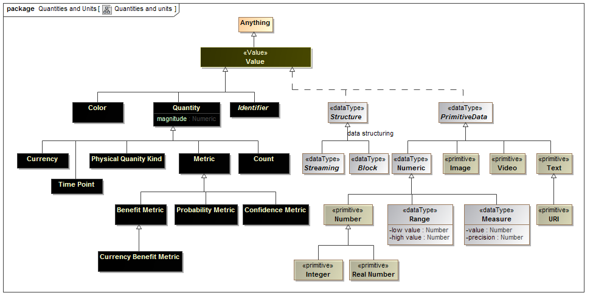

Slide 55
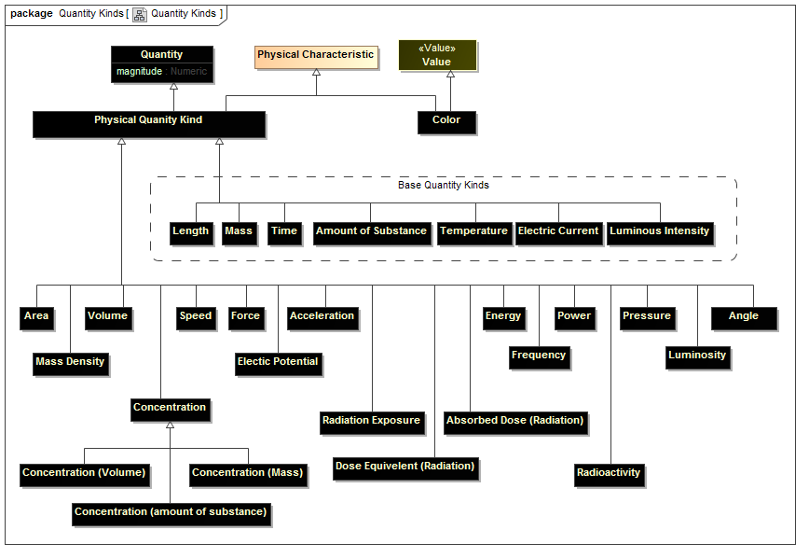
Quantity Kinds – for conceptual models

Slide 56
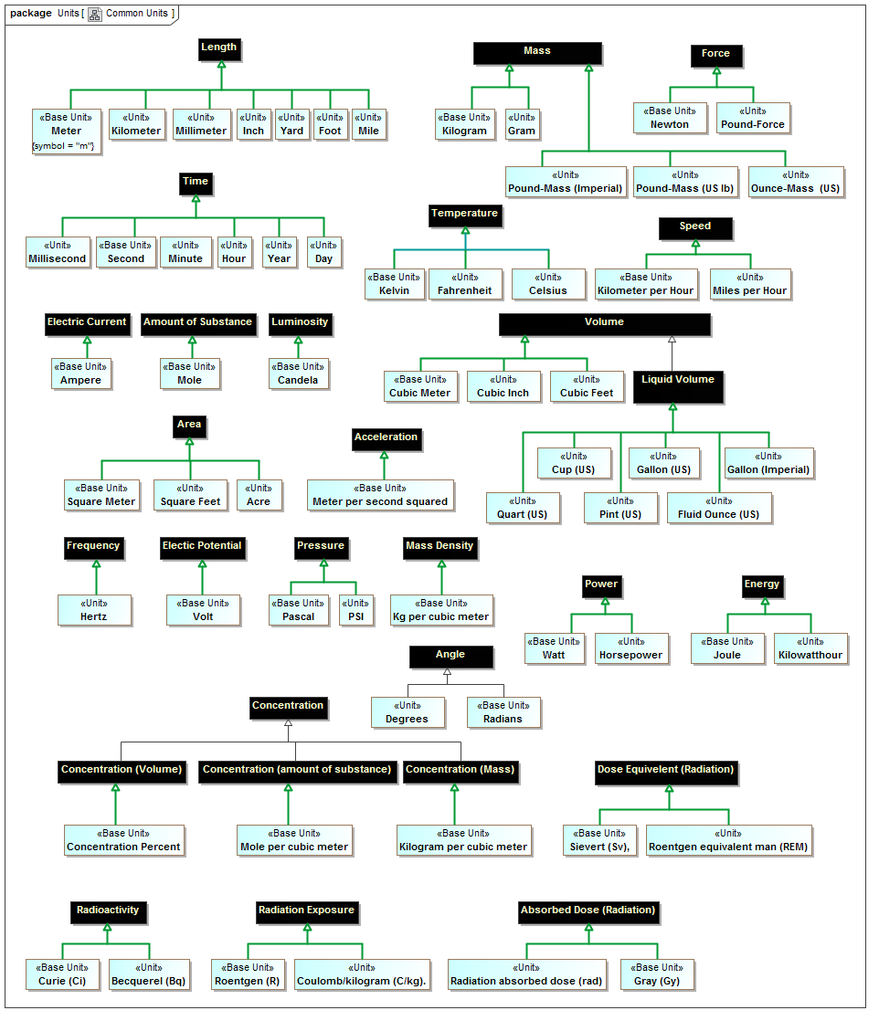

Slide 57
Mapping Semantics
High-level mapping as “represents” relations at the type level
Detail mappings as template patterns using UML
Mappings are bi-directional
Mapping patterns are still be proven in prototype

Slide 58
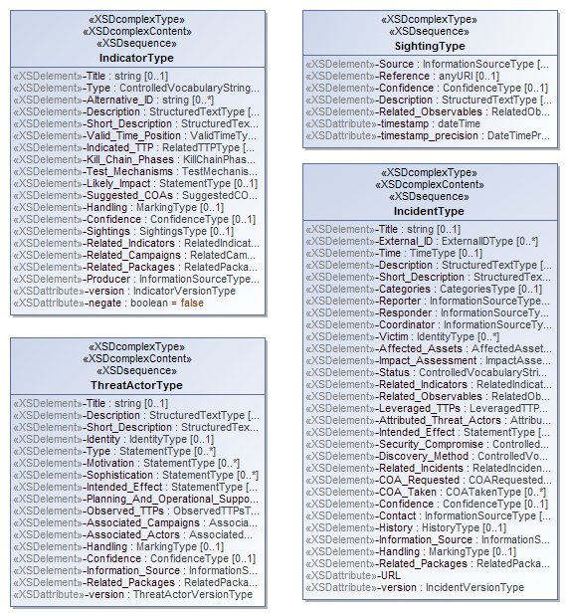
Representing the STIX physical model
<xs:complexContent>
<xs:extension base="stixCommon:IndicatorBaseType">
<xs:sequence>
<xs:element name="Title" type="xs:string" minOccurs="0">
<xs:annotation>
<xs:documentation>The Title field provides a simple title for this Indicator.</xs:documentation>
</xs:annotation>
</xs:element>
<xs:element name="Type" type="stixCommon:ControlledVocabularyStringType" minOccurs="0" maxOccurs="unbounded">
<xs:annotation>
<xs:documentation>Specifies the type or types for this Indicator.</xs:documentation>
<xs:documentation>This field is implemented through the xsi:type controlled vocabulary extension mechanism. The default vocabulary type is IndicatorTypeVocabularyType in the http://stix.mitre.org/default_vocabularies-1 namespace. This type is defined in the stix_default_vocabularies.xsd file or at the URL http://stix.mitre.org/XMLSchema/default_vocabularies/1.1.1/stix_default_vocabularies.xsd.</xs:documentation>
<xs:documentation>Users may also define their own vocabulary using the type extension mechanism, specify a vocabulary name and reference using the attributes, or simply use this as a string field.</xs:documentation>
</xs:annotation>
</xs:element>
<xs:element name="Alternative_ID" type="xs:string" minOccurs="0" maxOccurs="unbounded">
<xs:annotation>
<xs:documentation>Specifies an alternative identifier (or alias) for the cyber threat Indicator.</
XML Schema is reverse engineered into UML

Slide 59
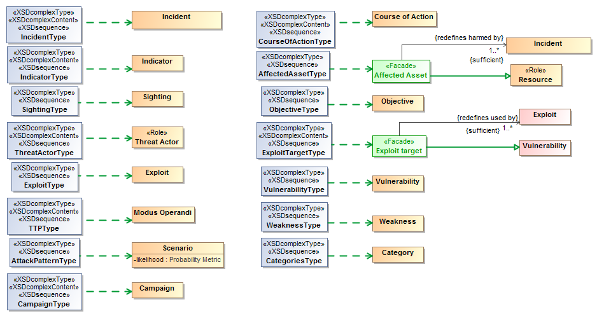
XML Representation represents concept
We start with the high-level classes

Slide 60
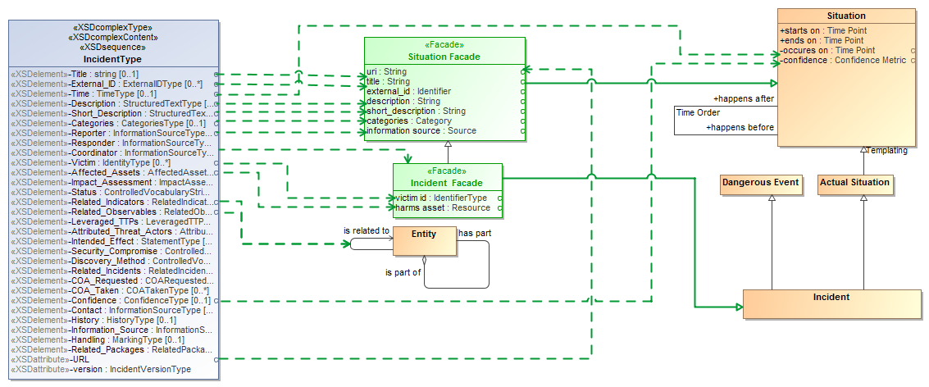
“Facades” provide mapped views of the conceptual model

Slide 61
Physical/logical elements represent concepts (may be in facades)

Slide 62
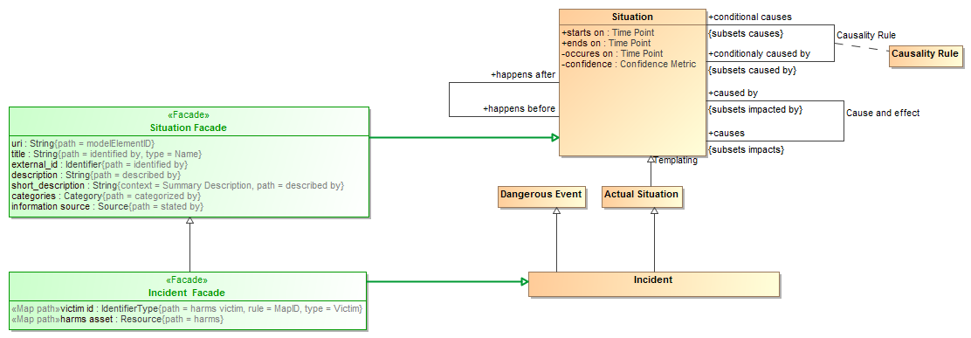
Facades utilize representations and property paths

Slide 63
Facades utilize representations and property paths

Slide 64
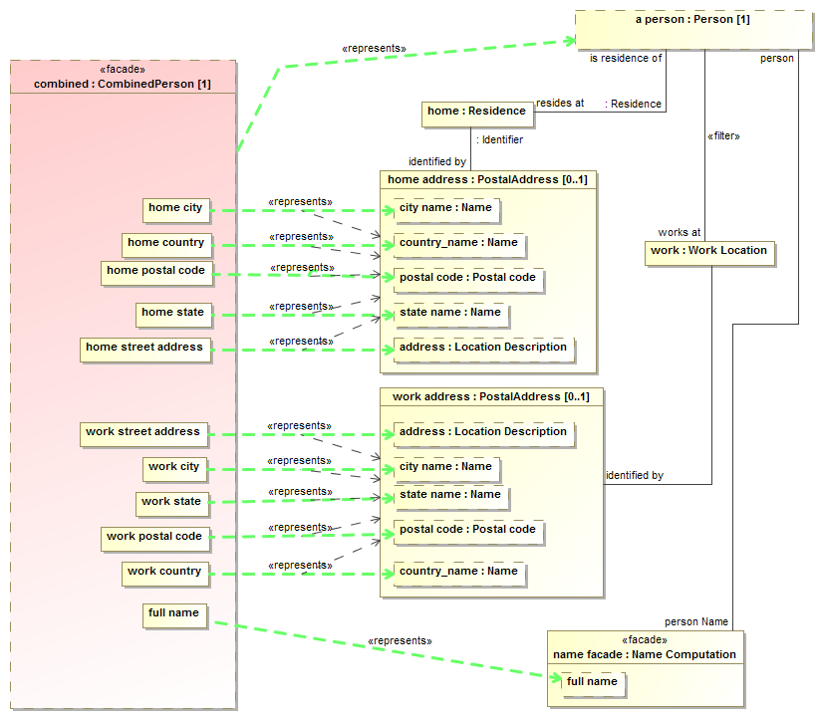
Mapping patterns for complex relations

Slide 65
Example STIX source data
<stix:Incident id="example:incident-fd56fb34-af59-47b3-95cf-7baaaa53fe93" timestamp="2014-08-28T16:42:52.859547+00:00" xsi:type='incident:IncidentType' version="1.1.1">
<incident:Title>Breach of Canary Corp</incident:Title>
<incident:Time>
<incident:Incident_Discovery precision="second">2013-01-13T00:00:00</incident:Incident_Discovery>
</incident:Time>
<incident:Description>Intrusion into enterprise network</incident:Description>
<incident:Reporter>
<stixCommon:Description>The person who reported it</stixCommon:Description>
<stixCommon:Identity id="example:Identity-5db269cf-e603-4df9-ae8c-51ff295abfaa">
<stixCommon:Name>Sample Investigations, LLC</stixCommon:Name>
</stixCommon:Identity>
<stixCommon:Time>
<cyboxCommon:Produced_Time>2014-03-11T00:00:00</cyboxCommon:Produced_Time>
</stixCommon:Time>
</incident:Reporter>
<incident:Victim id="example:Identity-c85082f3-bc04-43c8-a000-e0c1d0f2c045">
<stixCommon:Name>Canary Corp</stixCommon:Name>
</incident:Victim>
<incident:Impact_Assessment>
<incident:Effects>
<incident:Effect xsi:type="stixVocabs:IncidentEffectVocab-1.0">Financial Loss</incident:Effect>
</incident:Effects>
</incident:Impact_Assessment>
<incident:Confidence timestamp="2014-08-28T16:42:52.859570+00:00">
<stixCommon:Value xsi:type="stixVocabs:HighMediumLowVocab-1.0">High</stixCommon:Value>
</incident:Confidence>
</stix:Incident>

Slide 66
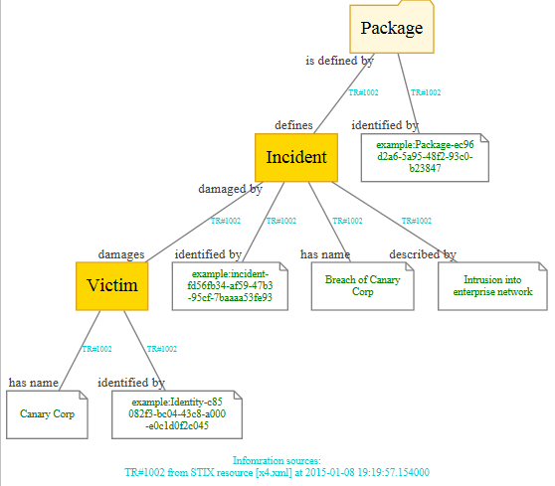
Example of mapped data graph
Provenance

Slide 67
Prototyping
Prototype is intended to validate models and mappings, it is not efficient or production code (yet). It is implemented in Python and all data is in-memory – last running prototype was last year.

Slide 68
Prototype Design
Magicdraw
Currently just does STIX
Conceptual
Model
STIX
XML
SIMF-Python Interpret / Export
Python Mapping Code
Files From Model
Rules
Output
Dictionary Spreadsheet
(Concept Labels)
SIMF/ Python Objects
Map rules
SIMF-XML
Objects
Object
Graph
Map log
(Data seen and mapped or not)
Extend
Rules

Slide 69
Example Dictionary
Dictionary
Example
From Model
Entity kinds/Physical Entity | A thing that has mass and takes up space including people, places and things.
UML2 Metamodel/Generalization
Intent/has intent
Context/Type
RiskThreat/has sighting
Possession/possesses
RiskThreat/damages

Slide 70
Map log example
What was mapped to what
MAP:/stix/core/stix_package/STIXPackage.indicators---MAPPED TO---><Indicator "opensource:indicator-45c112fa-805f-4cc0-b17b-2d98b519ca60" as "defines">
NO VALUE FOR RULE:/stix/core/stix_package/STIXPackage.incidents
NO VALUE FOR RULE:/stix/core/stix_package/STIXPackage.ttps
MAP:/stix/base/Entity.id_---MAPPED TO---><"edge:Package-3ffdccc7-bd56-4491-88d1-be3d966e42f8" as "identified by">
NO VALUE FOR RULE:/stix/base/Entity.idref
NO VALUE FOR RULE:/stix/base/Entity.title
NO VALUE FOR RULE:/stix/base/Entity.description.value
------UNMAPPED properties and get methods-------
IN:/stix/core/stix_package/STIXPackage.version = 1.1.1
IN:/stix/core/stix_package/STIXPackage.related_packages = None
IN:/stix/core/stix_package/STIXPackage.timestamp = 2014-11-23 00:12:45.650946+00:00
IN:/stix/core/stix_package/STIXPackage.campaigns = []
Input data to consider

Slide 71
Example rules*
Represents("/stix/ttp/TTP", "Behavior/Modus Operandi")
Represents("/stix/ttp/TTP.behavior", "Core Concepts/step")
Represents("/stix/ttp/behavior/Behavior", "Process/Plan")
Represents("/stix/ttp/behavior/Behavior.malware", "Process/requires")
Represents("/cybox/common/datetimewithprecision/DateTimeWithPrecision",
"Quantities and units/Time point")
Represents("/cybox/common/datetimewithprecision/DateTimeWithPrecision.value", "Quantity/value")
#Entity properties used for all subtypes
RepresentsID("/stix/base/Entity.id_", "Core Concepts/identified by")
RepresentsID("/stix/base/Entity.idref", "Core Concepts/identified by")
Represents("/stix/base/Entity.title", "Information/has name")
Represents("/stix/base/Entity.description.value", "Information/described by")
From schema and map log
From conceptual dictionary
* Currently in text format

Slide 72
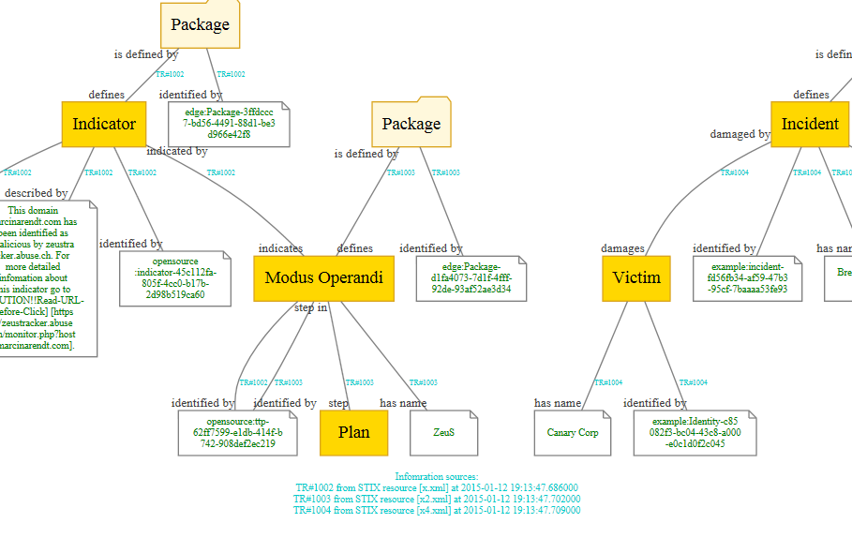
Resulting data graph

Slide 73
Threat/Risk RFP Requirements

Slide 74
Conceptual Models
Submissions shall define modular UML conceptual models to specify the concepts required to represent information about operational threats and risks.
The conceptual model shall capture the intended meaning of operational threat and risk related concepts such that it may be used as a reference for the use of those concepts in specific exchanges and data stores.
The conceptual model shall not assume any particular technology, domain, representation, structure of information or schema. It shall be a model of the concepts representing real-world entities, not of a specific data representation.

Slide 75
Threat/Risk Concepts To Define
Operational Threat
Operational Risk
Asset
Campaign
Cause
Effect
Exploit target
Goal
Hazard
Impact
Incident
Indicator
Likelihood
Mitigation
Observable
Observation
Observation Metadata
Procedures
Risk
Safeguard
Severity
Strategy
Tactics
Techniques
Threat
Threat actor
Threat source
Undesired event

Slide 76
Classes of Threat/Risks in scope
Cyber/information and communication systems and assets
Physical systems and assets, including embedded and manufacturing
Electromagnetic spectrum assets (E.g. interference with wireless systems or radio)
Industrial control systems

Slide 77
Constraints
Defensive, offensive, or other actors may or may not have insight into the plans or strategies of the respective other actors. As such, model implementations will in those cases be incomplete and rely on estimates and assumed parameters.
Models must be able to support non-actor threats (such as natural disasters ) that will not be associated with any coherent intentions or plans.
Bystanders and inadvertent actors may perform actions that result in behavior that provides benefits to any other actor (offensive or defensive). Such actions are understood to be non-intentional.
The focus of risks will be those that go beyond the normal course of business and expose the enterprise to increased risk due to threats & vulnerabilities.
Unclear what level of behavioural modeling you have in mind, but in general it could be expected that an offensive actor would have an understanding of the plans of defensive actors [Done-CBC (Also MH)]
6.5.2.5 Models for operational threats and risks shall include concepts for expressing probability and/or confidence levels (e.g. for likelihood of occurrence and impact)
The conceptual model shall include concepts for understanding, planning for and treating operational risks, threats and their contingencies at the governmental and enterprise level.

Slide 78
NIEM Representation & Mapping
Submissions shall define a normative NIEM-UML PIM representation sufficient to capture the concepts as defined in the conceptual models as defined above.
This NIEM-UML representation shall be mapped to the conceptual models such that the meaning of each threat/risk relevant NIEM element is described in the conceptual model.
The mapping shall be sufficiently expressive such that any set of instances represented in or logically mapped to the conceptual model shall be able to be represented in NIEM (understanding that choices and rules will have to be made).
Any instance of the NIEM specification shall be able to be logically mapped to the conceptual model.

Slide 79
STIX Mapping
Submissions shall define a mapping to the subset of STIX that corresponds with the conceptual model. This mapping shall demonstrate that the conceptual model is sufficient to represent high-level STIX concepts.

Slide 80
Common Requirements
All models shall utilize UML and UML profiles as a foundation.
Concepts that are required for understanding threats or risks should, as much as possible, be defined in a modular fashion such that these concepts may be reused for related threat/risk concepts NIEM and other reference models shall be used as a reference for such cross-domain concepts.

Slide 81
Optional Mappings
Submissions may provide normative or non-normative mappings to support the following Platform Specific Models, or logical models for the following protocols or communities:
OASIS Common Alerting Program & EDXL
Others as deemed important by submitters

Slide 82
Optional support for conceptual modeling and mapping
Submissions may reference and/or define non-normative UML profiles and associated QVT (or other ways to express mapping logic) for conceptual modeling and the mapping.
Submitters are encouraged to follow the progress of and use as appropriate SIMF, ODM, MDMI, semantic web and other efforts to help define conceptual models and mappings.

Slide 83
MOF Representation
Submissions may define A MOF metamodel that utilizes the conceptual model and provides an XMI representation of Operational Threats and Risks.

Slide 84
Optional Integration with UPDM
Submissions may define conceptual integration points with UPDM.

Slide 85
Issues To Discuss
Simulation
Applicability
Design choices

Slide 86
Evaluation Criteria
6.8.1 Situational Awareness
Submissions shall be evaluated based on their ability to support broad-based situational awareness about operational threats and risks and represent appropriate courses of action.
6.8.2 Enterprise planning, assessment and architecture
Submissions shall be evaluated based on their applicability to support the planning and assessment for operational risks, threats and mitigations.
6.8.3 Completeness
Submissions shall be evaluated based on the completeness of the representation of operational threat and risk concepts
6.8.4 Fidelity
Submissions shall be evaluated based on their proof of fidelity with existing operational threat and risk specifications and best practices.
6.8.5 Extensibility
Submissions shall be evaluated based on the ability of their approach to be extended to other domains and more detailed levels of granularity in future efforts.
6.8.6 Fit for purpose as defined by use cases
Submissions shall be evaluated based on their ability to support the use cases referenced in section6.1.4.
6.8.7 Understandability
Submissions shall be evaluated based on the ability of non-technical stakeholders to understand the conceptual models and for technologists to understand the relationship of those models to their technology frameworks and representations.

Slide 87
Team Discussions

